Slide 1
Chapter 7
Digital Design and Computer Architecture: ARM® Edition
Sarah L. Harris and David Money Harris

Slide 2
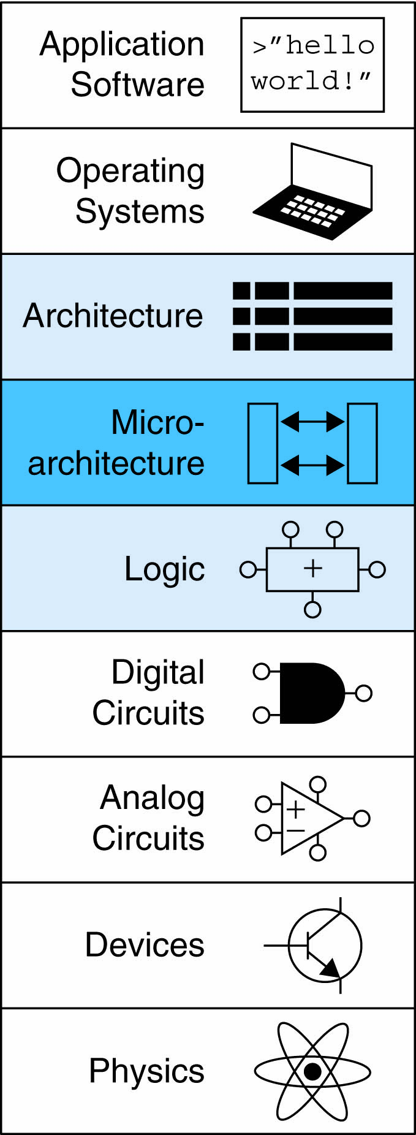
Chapter 7 :: Topics
Introduction
Performance Analysis
Single-Cycle Processor
Multicycle Processor
Pipelined Processor
Advanced Microarchitecture

Slide 3
Introduction
Microarchitecture: how to implement an architecture in hardware
Processor:
Datapath: functional blocks
Control: control signals

Slide 4
Microarchitecture
Multiple implementations for a single architecture:
Single-cycle: Each instruction executes in a single cycle
Multicycle: Each instruction is broken up into series of shorter steps
Pipelined: Each instruction broken up into series of steps & multiple instructions execute at once

Slide 5
Processor Performance
Program execution time
Execution Time = (#instructions)(cycles/instruction)(seconds/cycle)
Definitions:
CPI: Cycles/instruction
clock period: seconds/cycle
IPC: instructions/cycle = IPC
Challenge is to satisfy constraints of:
Cost
Power
Performance

Slide 6
ARM Processor
Consider subset of ARM instructions:
Data-processing instructions:
ADD, SUB, AND, ORR
with register and immediate Src2, but no shifts
Memory instructions:
LDR, STR
with positive immediate offset
Branch instructions:
B

Slide 7
Architectural State Elements
Determines everything about a processor:
Architectural state:
16 registers (including PC)
Status register
Memory

Slide 8
ARM Architectural State Elements

Slide 9
Single-Cycle ARM Processor
Datapath
Control

Slide 10
Single-Cycle ARM Processor
Datapath
Control

Slide 11
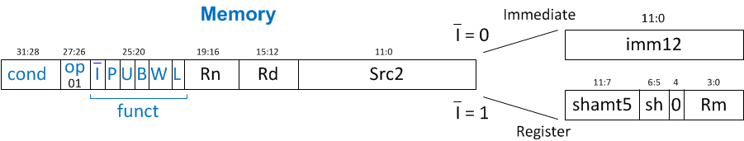
Single-Cycle ARM Processor
Datapath: start with LDR instruction
Example: LDR R1, [R2, #5]
LDR Rd, [Rn, imm12]

Slide 12
Single-Cycle Datapath: LDR fetch
STEP 1: Fetch instruction

Slide 13
Single-Cycle Datapath: LDR Reg Read
STEP 2: Read source operands from RF
LDR Rd, [Rn, imm12]

Slide 14
Single-Cycle Datapath: LDR Immed.
STEP 3: Extend the immediate
LDR Rd, [Rn, imm12]

Slide 15
Single-Cycle Datapath: LDR Address
STEP 4: Compute the memory address
LDR Rd, [Rn, imm12]

Slide 16
Single-Cycle Datapath: LDR Mem Read
STEP 5: Read data from memory and write it back to register file
LDR Rd, [Rn, imm12]

Slide 17
Single-Cycle Datapath: PC Increment
STEP 6: Determine address of next instruction

Slide 18
Single-Cycle Datapath: Access to PC
PC can be source/destination of instruction

Slide 19
Single-Cycle Datapath: Access to PC
PC can be source/destination of instruction
Source: R15 must be available in Register File
PC is read as the current PC plus 8

Slide 20
Single-Cycle Datapath: Access to PC
PC can be source/destination of instruction
Source: R15 must be available in Register File
PC is read as the current PC plus 8
Destination: Be able to write result to PC

Slide 21
Single-Cycle Datapath: STR
Expand datapath to handle STR:
Write data in Rd to memory
STR Rd, [Rn, imm12]

Slide 22
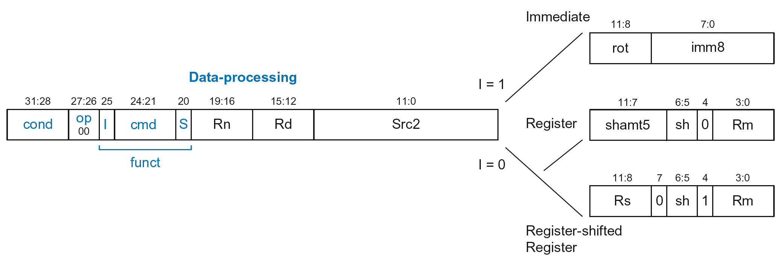
Single-Cycle Datapath: Data-processing
With immediate Src2:
Read from Rn and Imm8 (ImmSrc chooses the zero-extended Imm8 instead of Imm12)
Write ALUResult to register file
Write to Rd
ADD Rd, Rn, imm8

Slide 23
Single-Cycle Datapath: Data-processing
With immediate Src2:
Read from Rn and Imm8 (ImmSrc chooses the zero-extended Imm8 instead of Imm12)
Write ALUResult to register file
Write to Rd
ADD Rd, Rn, imm8

Slide 24
Single-Cycle Datapath: Data-processing
With register Src2:
Read from Rn and Rm (instead of Imm8)
Write ALUResult to register file
Write to Rd
ADD Rd, Rn, Rm

Slide 25
Single-Cycle Datapath: Data-processing
With register Src2:
Read from Rn and Rm (instead of Imm8)
Write ALUResult to register file
Write to Rd
ADD Rd, Rn, Rm

Slide 26
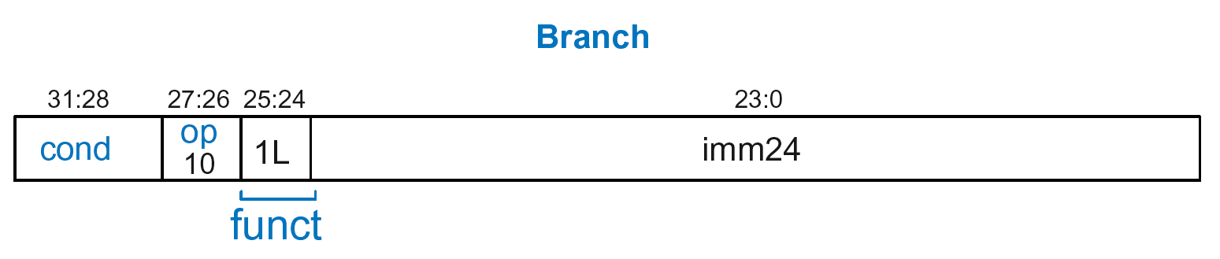
Single-Cycle Datapath: B
Calculate branch target address:
BTA = (ExtImm) + (PC + 8)
ExtImm = Imm24 << 2 and sign-extended
B Label

Slide 27
Single-Cycle Datapath: ExtImm
ImmSrc_{1:0} | ExtImm | Description
00 | {24’b0, Instr_{7:0}} | Zero-extended imm8
01 | {20’b0, Instr_{11:0}} | Zero-extended imm12
10 | {6{Instr₂₃}, Instr_{23:0}} | Sign-extended imm24

Slide 28
Single-Cycle ARM Processor

Slide 29
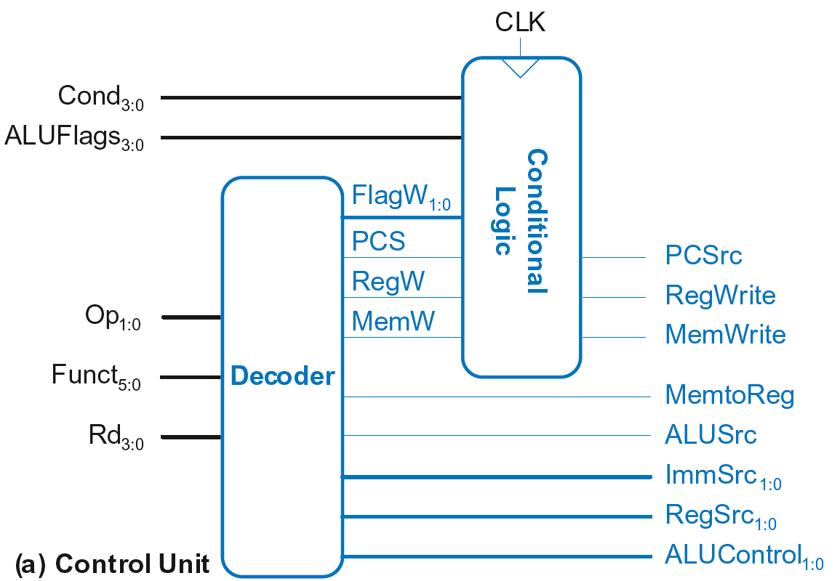
Single-Cycle Control

Slide 30
Single-Cycle Control
Sent directly
to datapath

Slide 31
Single-Cycle Control
Sent through
Conditional Logic
first, then to
datapath
Sent directly
to datapath

Slide 32
Single-Cycle Control
These signals change the state (PC, RF, Memory)
If instruction shouldn’t execute, forced to 0
Sent through
Conditional Logic
first, then to
datapath
Sent directly
to datapath

Slide 33
Single-Cycle Control
FlagW_{1:0}: Flag Write signal, asserted when ALUFlags should be saved (i.e., on instruction with S=1)

Slide 34
Single-Cycle Control
FlagW_{1:0}: Flag Write signal, asserted when ALUFlags should be saved (i.e., on instruction with S=1)
ADD, SUB update all flags (NZCV)
AND, ORR only update NZ flags

Slide 35
Single-Cycle Control
FlagW_{1:0}: Flag Write signal, asserted when ALUFlags should be saved (i.e., on instruction with S=1)
ADD, SUB update all flags (NZCV)
AND, ORR only update NZ flags
So, two bits needed:
FlagW₁ = 1: NZ saved (ALUFlags_{3:2} saved)
FlagW₀ = 1: CV saved (ALUFlags_{1:0} saved)

Slide 36
Single-Cycle Control

Slide 37
Single-Cycle Control: Decoder

Slide 38
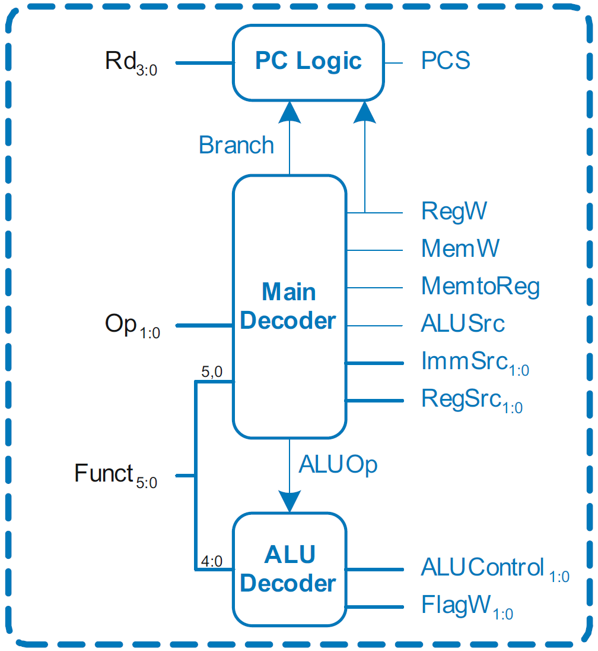
Single-Cycle Control: Decoder
Submodules:
Main Decoder
ALU Decoder
PC Logic

Slide 39
Single-Cycle Control: Decoder
Submodules:
Main Decoder
ALU Decoder
PC Logic

Slide 40
Control Unit: Main Decoder
Op | Funct₅ | Funct₀ | Type | Branch | MemtoReg | MemW | ALUSrc | ImmSrc | RegW | RegSrc | ALUOp
00 | 0 | X | DP Reg | 0 | 0 | 0 | 0 | XX | 1 | 00 | 1
00 | 1 | X | DP Imm | 0 | 0 | 0 | 1 | 00 | 1 | X0 | 1
01 | X | 0 | STR | 0 | X | 1 | 1 | 01 | 0 | 10 | 0
01 | X | 1 | LDR | 0 | 1 | 0 | 1 | 01 | 1 | X0 | 0
11 | X | X | B | 1 | 0 | 0 | 1 | 10 | 0 | X1 | 0

Slide 41
Single-Cycle Control: Decoder
Submodules:
Main Decoder
ALU Decoder
PC Logic

Slide 42
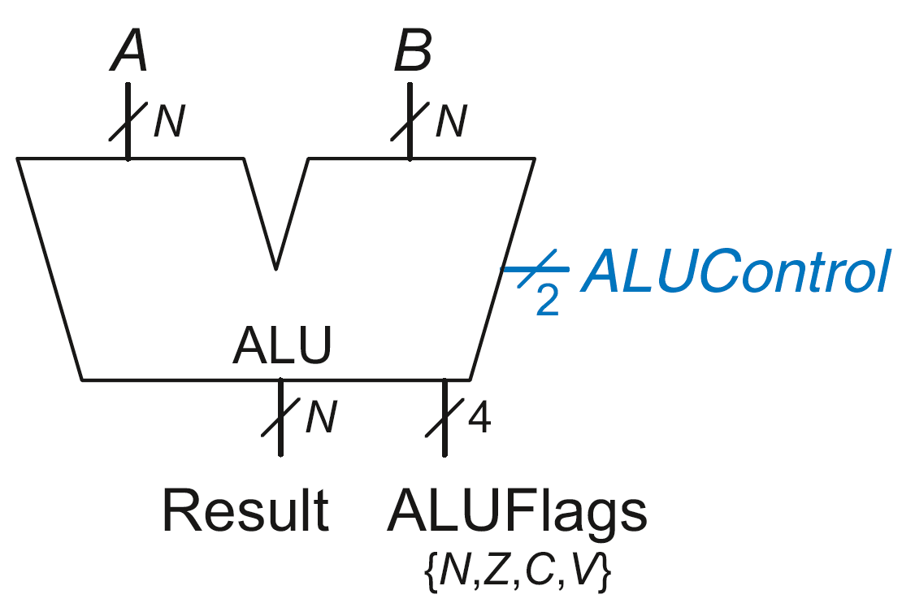
Review: ALU
ALUControl_{1:0} | Function
00 | Add
01 | Subtract
10 | AND
11 | OR

Slide 43
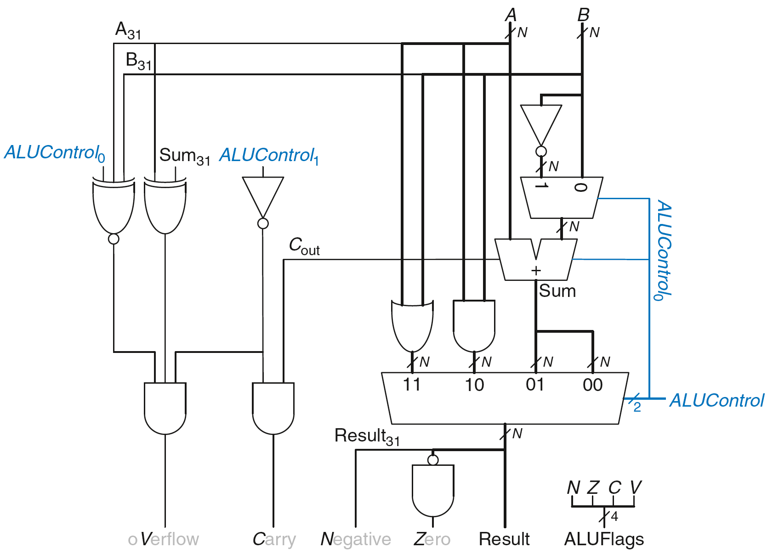
Review: ALU

Slide 44
Single-Cycle Control: Decoder
Submodules:
Main Decoder
ALU Decoder
PC Logic

Slide 45
Control Unit: ALU Decoder
ALUOp | Funct_{4:1} (cmd) | Funct₀ (S) | Type | ALUControl_{1:0} | FlagW_{1:0}
0 | X | X | Not DP | 00 | 00
1 | 0100 | 0 | ADD | 00 | 00
 |  | 1 |  |  | 11
 | 0010 | 0 | SUB | 01 | 00
 |  | 1 |  |  | 11
 | 0000 | 0 | AND | 10 | 00
 |  | 1 |  |  | 10
 | 1100 | 0 | ORR | 11 | 00
 |  | 1 |  |  | 10
FlagW₁ = 1: NZ (Flags_{3:2}) should be saved
FlagW₀ = 1: CV (Flags_{1:0}) should be saved

Slide 46
Single-Cycle Control: Decoder
Submodules:
Main Decoder
ALU Decoder
PC Logic

Slide 47
Single-Cycle Control: PC Logic
PCS = 1 if PC is written by an instruction or branch (B):
PCS = ((Rd == 15) & RegW) | Branch
If instruction is executed: PCSrc = PCS
Else PCSrc = 0 (i.e., PC = PC + 4)

Slide 48
Single-Cycle Control

Slide 49
Single-Cycle Control: Cond. Logic

Slide 50
Conditional Logic
Function:
Check if instruction should execute (if not, force PCSrc, RegWrite, and MemWrite to 0)
Possibly update Status Register (Flags_{3:0})

Slide 51
Conditional Logic
Function:
Check if instruction should execute (if not, force PCSrc, RegWrite, and MemWrite to 0)
Possibly update Status Register (Flags_{3:0})

Slide 52
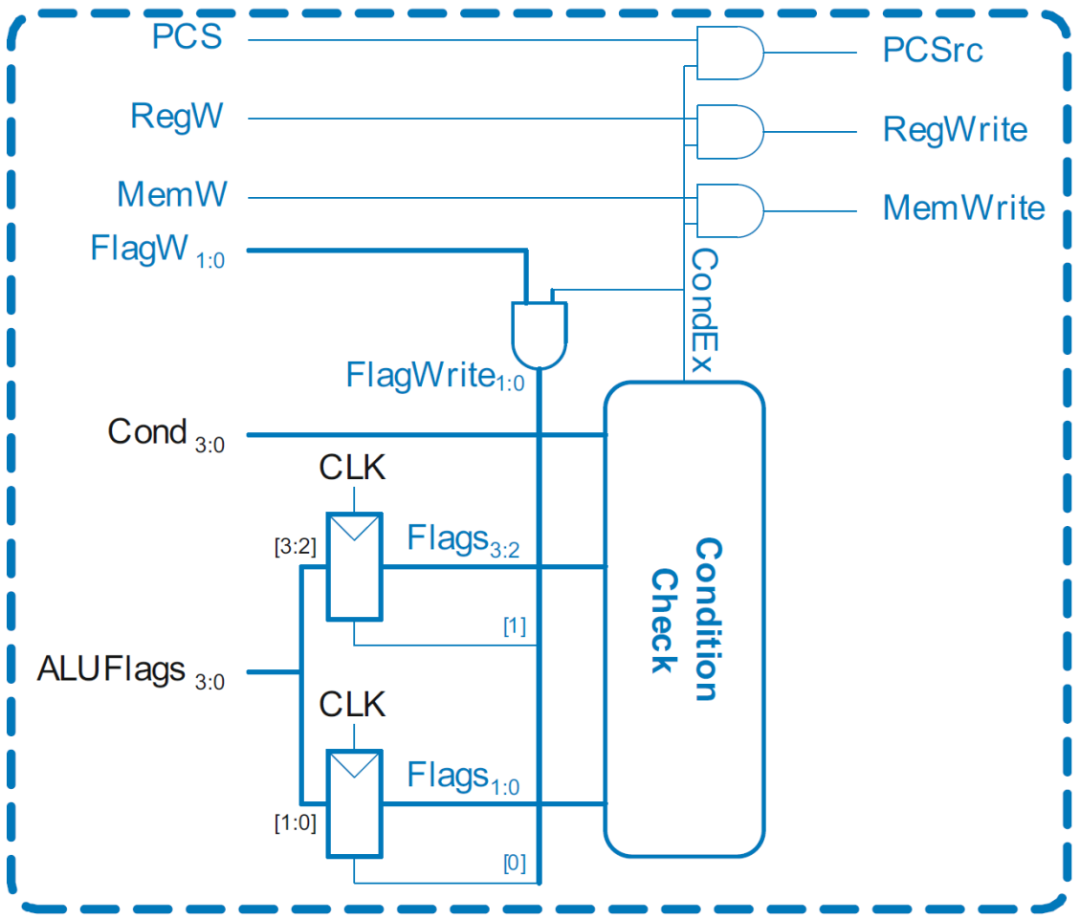
Single-Cycle Control: Conditional Logic

Slide 53
Conditional Logic: Conditional Execution
Depending on condition mnemonic (Cond_{3:0}) and condition flags (Flags_{3:0}) the instruction is executed (CondEx = 1)

Slide 54
Conditional Logic: Conditional Execution
Flags_{3:0} is the status register
Depending on condition mnemonic (Cond_{3:0}) and condition flags (Flags_{3:0}) the instruction is executed (CondEx = 1)

Slide 55
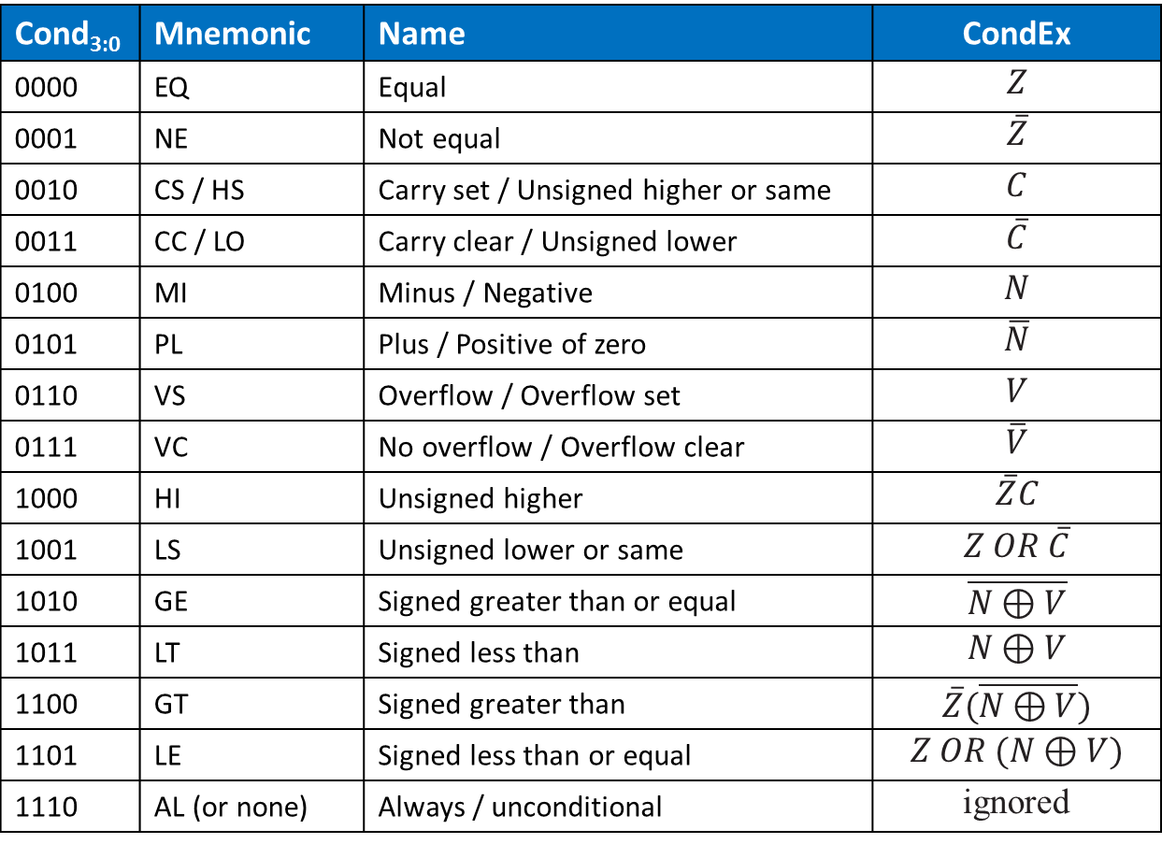
Review: Condition Mnemonics
Cond_{3:0} | Mnemonic | Name | CondEx
0000 | EQ | Equal | $$Z$$
0001 | NE | Not equal | $$\overline{Z}$$
0010 | CS / HS | Carry set / Unsigned higher or same | $$C$$
0011 | CC / LO | Carry clear / Unsigned lower | $$\overline{C}$$
0100 | MI | Minus / Negative | $$N$$
0101 | PL | Plus / Positive of zero | $$\overline{N}$$
0110 | VS | Overflow / Overflow set | $$V$$
0111 | VC | No overflow / Overflow clear | $$\overline{V}$$
1000 | HI | Unsigned higher | $$\overline{Z}C$$
1001 | LS | Unsigned lower or same | $$Z OR \overline{C}$$
1010 | GE | Signed greater than or equal | $$\overline{N⊕V}$$
1011 | LT | Signed less than | $$N⊕V$$
1100 | GT | Signed greater than | $$\overline{Z}(\overline{N⊕V})$$
1101 | LE | Signed less than or equal | $$Z OR (N⊕V)$$
1110 | AL (or none) | Always / unconditional | ignored

Slide 56
Conditional Logic: Conditional Execution
Flags_{3:0} = NZCV
Example: AND R1, R2, R3
Cond_{3:0}=1110 (unconditional) => CondEx = 1

Slide 57
Conditional Logic: Conditional Execution
Flags_{3:0} = NZCV
Example: EOREQ R5, R6, R7
Cond_{3:0}=0000 (EQ): if Flags_{3:2}=0100 => CondEx = 1

Slide 58
Conditional Logic
Function:
Check if instruction should execute (if not, force PCSrc, RegWrite, and MemWrite to 0)
Possibly update Status Register (Flags_{3:0})

Slide 59
Conditional Logic: Update (Set) Flags
Flags_{3:0} = NZCV
Flags_{3:0} updated (with ALUFlags_{3:0}) if:
FlagW is 1 (i.e., the instruction’s S-bit is 1) AND
CondEx is 1 (the instruction should be executed)

Slide 60

Conditional Logic: Update (Set) Flags
Recall:
ADD, SUB update all Flags
AND, OR update NZ only
So Flags status register has two write enables: FlagW_{1:0}

Slide 61
Review: ALU Decoder
ALUOp | Funct_{4:1} (cmd) | Funct₀ (S) | Type | ALUControl_{1:0} | FlagW_{1:0}
0 | X | X | Not DP | 00 | 00
1 | 0100 | 0 | ADD | 00 | 00
 |  | 1 |  |  | 11
 | 0010 | 0 | SUB | 01 | 00
 |  | 1 |  |  | 11
 | 0000 | 0 | AND | 10 | 00
 |  | 1 |  |  | 10
 | 1100 | 0 | ORR | 11 | 00
 |  | 1 |  |  | 10
FlagW₁ = 1: NZ (Flags_{3:2}) should be saved
FlagW₀ = 1: CV (Flags_{1:0}) should be saved

Slide 62
Conditional Logic: Update (Set) Flags
All Flags updated
Example: SUBS R5, R6, R7
FlagW_{1:0} = 11 AND CondEx = 1 (unconditional) => FlagWrite_{1:0} = 11

Slide 63
Conditional Logic: Update (Set) Flags
Flags_{3:0} = NZCV
Only Flags_{3:2} updated
i.e., only NZ Flags updated
Example: ANDS R7, R1, R3
FlagW_{1:0} = 10 AND CondEx = 1 (unconditional) => FlagWrite_{1:0} = 10

Slide 64
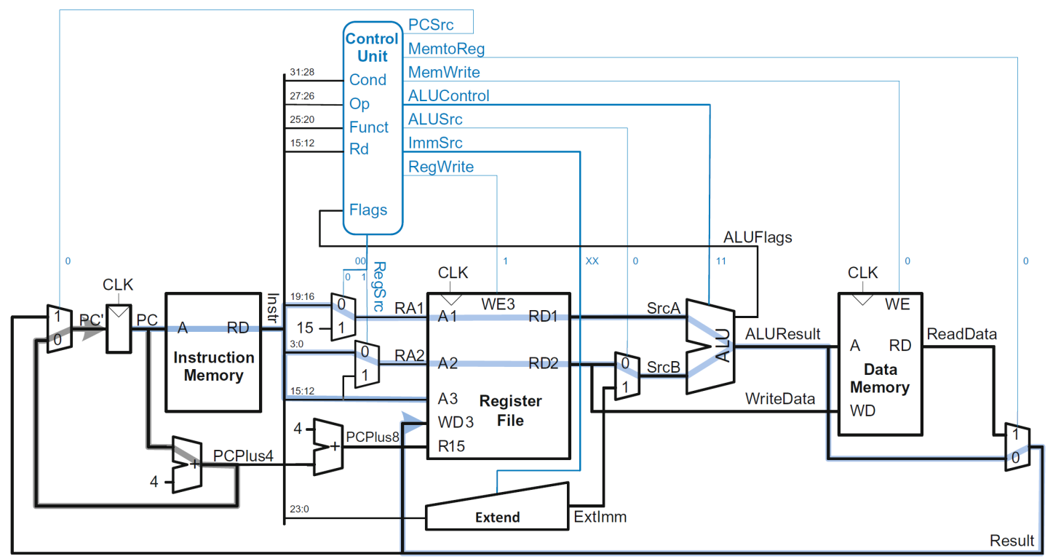
Example: ORR
Op | Funct₅ | Funct₀ | Type | Branch | MemtoReg | MemW | ALUSrc | ImmSrc | RegW | RegSrc | ALUOp
00 | 0 | X | DP Reg | 0 | 0 | 0 | 0 | XX | 1 | 00 | 1

Slide 65
Example: ORR

Slide 66
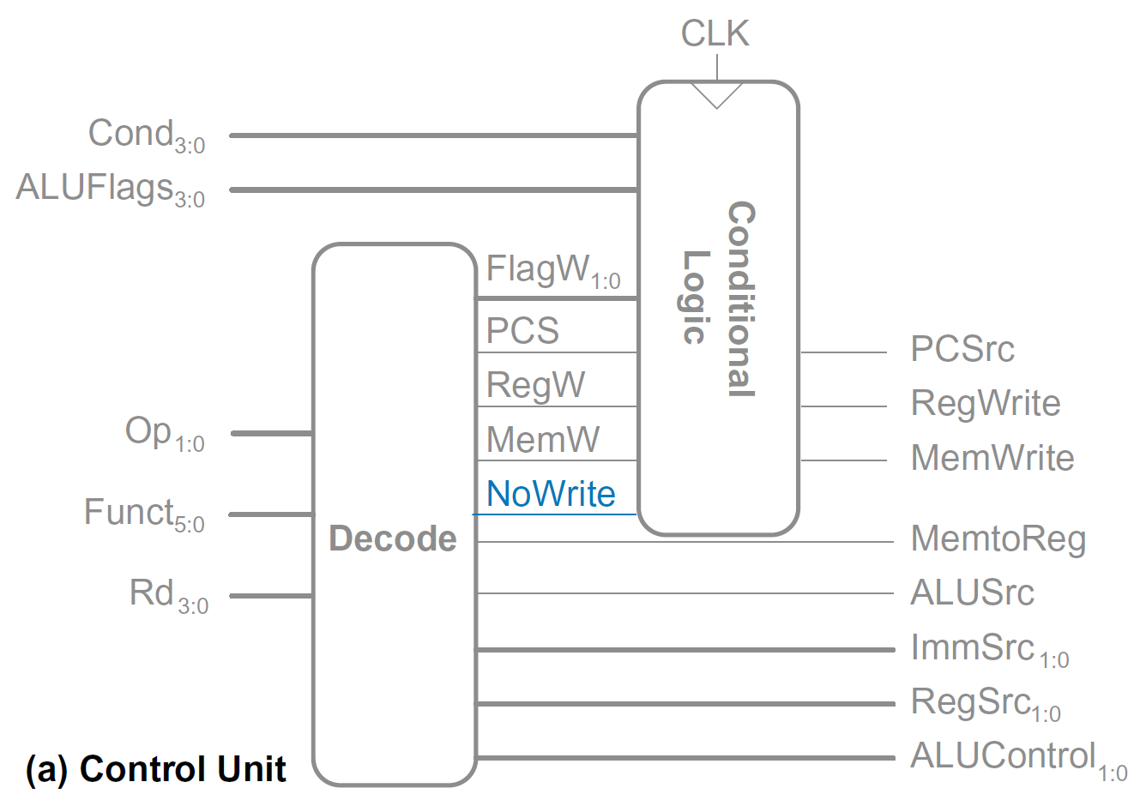
Extended Functionality: CMP

Slide 67
Extended Functionality: CMP
No change to datapath

Slide 68
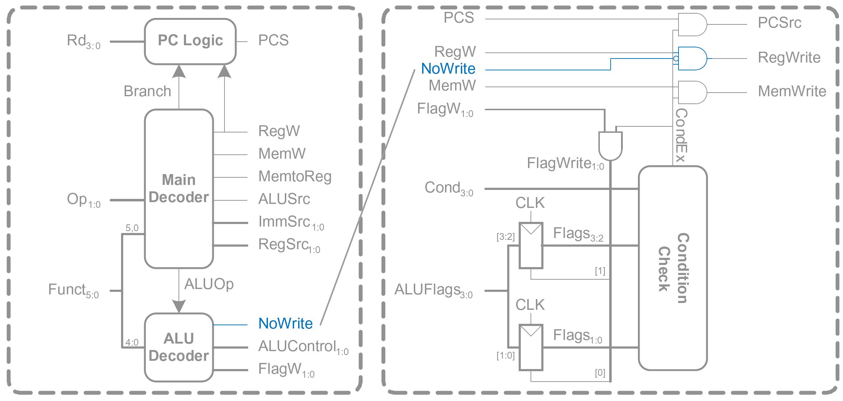
Extended Functionality: CMP

Slide 69
Extended Functionality: CMP
ALUOp | Funct_{4:1} (cmd) | Funct₀ (S) | Type | ALUControl_{1:0} | FlagW_{1:0} | NoWrite
0 | X | X | Not DP | 00 | 00 | 0
1 | 0100 | 0 | ADD | 00 | 00 | 0
 |  | 1 |  |  | 11 | 0
 | 0010 | 0 | SUB | 01 | 00 | 0
 |  | 1 |  |  | 11 | 0
 | 0000 | 0 | AND | 10 | 00 | 0
 |  | 1 |  |  | 10 | 0
 | 1100 | 0 | ORR | 11 | 00 | 0
 |  | 1 |  |  | 10 | 0
 | 1010 | 1 | CMP | 01 | 11 | 1

Slide 70
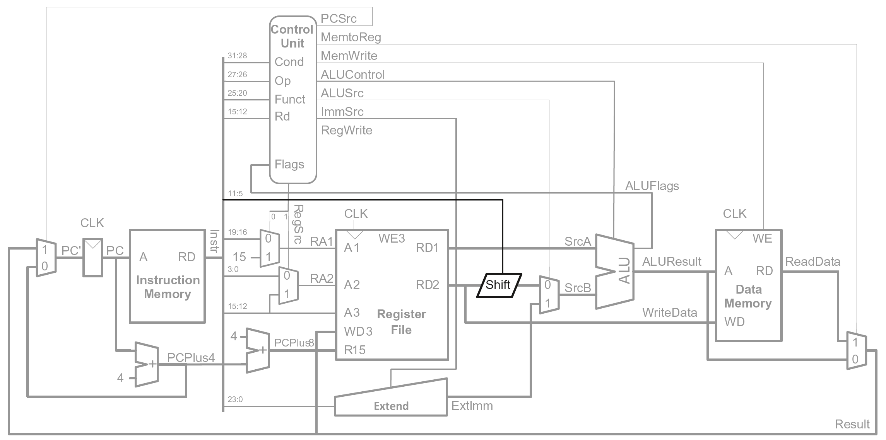
Extended Functionality: Shifted Register

Slide 71
Extended Functionality: Shifted Register
No change to controller

Slide 72
Review: Processor Performance
Program Execution Time
= (#instructions)(cycles/instruction)(seconds/cycle)
= # instructions x CPI x T_{C}

Slide 73
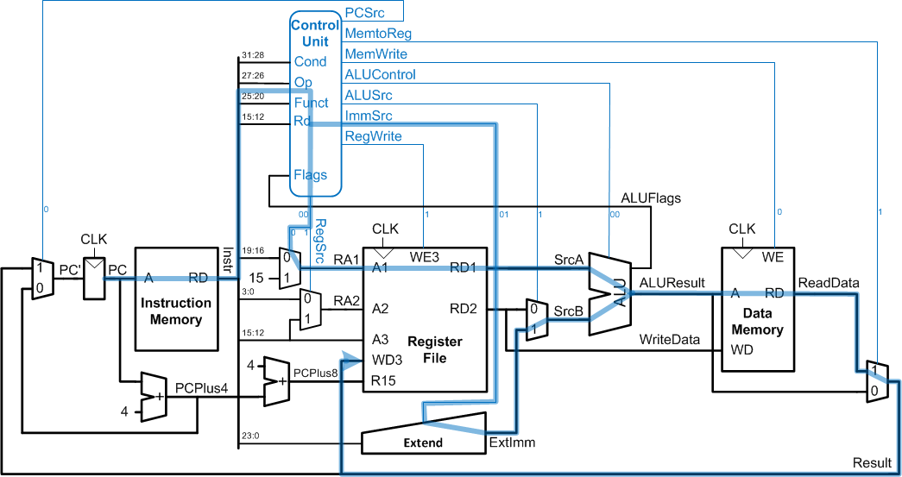
Single-Cycle Performance
T_{C} limited by critical path (LDR)

Slide 74
Single-Cycle Performance
Single-cycle critical path:
T_{c1} = t_{pcq_PC} + t_{mem} + t_{dec} + max[t_{mux} + t_{RFread}, t_{sext} + t_{mux}] + t_{ALU} + t_{mem} + t_{mux} + t_{RFsetup}
Typically, limiting paths are:
memory, ALU, register file
T_{c1} = t_{pcq_PC} + 2t_{mem} + t_{dec} + t_{RFread} + t_{ALU} + 2t_{mux} + t_{RFsetup}

Slide 75
Single-Cycle Performance Example
Element | Parameter | Delay (ps)
Register clock-to-Q | t_{pcq_PC} | 40
Register setup | t_{setup} | 50
Multiplexer | t_{mux} | 25
ALU | t_{ALU} | 120
Decoder | t_{dec} | 70
Memory read | t_{mem} | 200
Register file read | t_{RFread} | 100
Register file setup | t_{RFsetup} | 60
T_{c1} = ?

Slide 76
Single-Cycle Performance Example
Element | Parameter | Delay (ps)
Register clock-to-Q | t_{pcq_PC} | 40
Register setup | t_{setup} | 50
Multiplexer | t_{mux} | 25
ALU | t_{ALU} | 120
Decoder | t_{dec} | 70
Memory read | t_{mem} | 200
Register file read | t_{RFread} | 100
Register file setup | t_{RFsetup} | 60
T_{c1} = t_{pcq_PC} + 2t_{mem} + t_{dec} + t_{RFread} + t_{ALU} + 2t_{mux} + t_{RFsetup}
= [50 + 2(200) + 70 + 100 + 120 + 2(25) + 60] ps
= 840 ps

Slide 77
Single-Cycle Performance Example
Program with 100 billion instructions:
Execution Time = # instructions x CPI x T_{C}
= (100 × 10⁹)(1)(840 × 10⁻¹² s)
= 84 seconds

Slide 78
Multicycle ARM Processor
Single-cycle:
+ simple
cycle time limited by longest instruction (LDR)
separate memories for instruction and data
3 adders/ALUs
Multicycle processor addresses these issues by breaking instruction into shorter steps
shorter instructions take fewer steps
can re-use hardware
cycle time is faster

Slide 79
Multicycle ARM Processor
Single-cycle:
+ simple
cycle time limited by longest instruction (LDR)
separate memories for instruction and data
3 adders/ALUs
Multicycle:
+ higher clock speed
+ simpler instructions run faster
+ reuse expensive hardware on multiple cycles
- sequencing overhead paid many times

Slide 80
Multicycle ARM Processor
Single-cycle:
+ simple
cycle time limited by longest instruction (LDR)
separate memories for instruction and data
3 adders/ALUs
Multicycle:
+ higher clock speed
+ simpler instructions run faster
+ reuse expensive hardware on multiple cycles
- sequencing overhead paid many times
Same design steps as single-cycle:
first datapath
then control

Slide 81
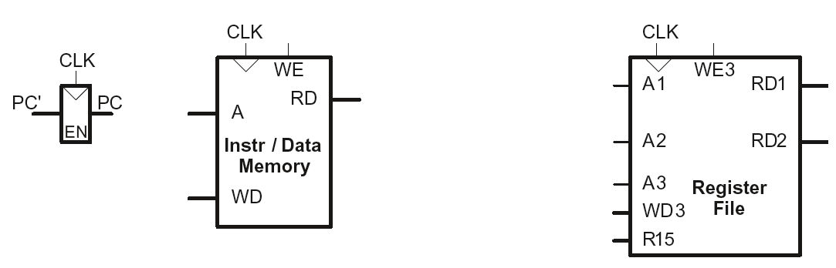
Multicycle State Elements
Replace Instruction and Data memories with a single unified memory – more realistic

Slide 82
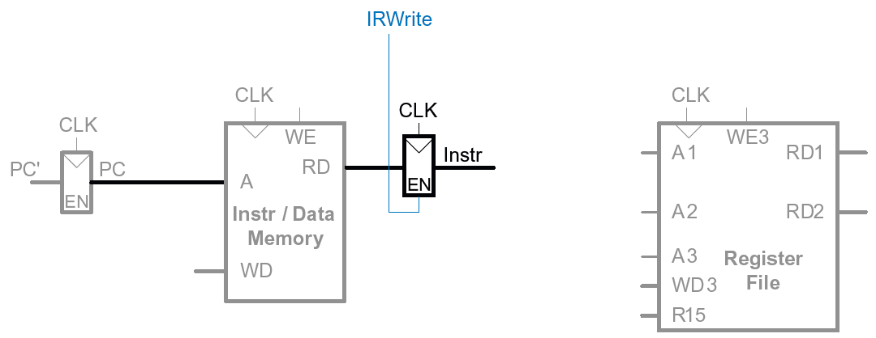
Multicycle Datapath: Instruction Fetch
STEP 1: Fetch instruction
LDR Rd, [Rn, imm12]

Slide 83
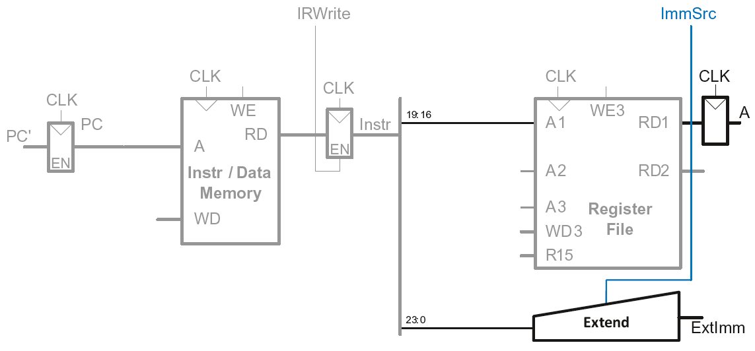
Multicycle Datapath: LDR Register Read
STEP 2: Read source operands from RF
LDR Rd, [Rn, imm12]

Slide 84
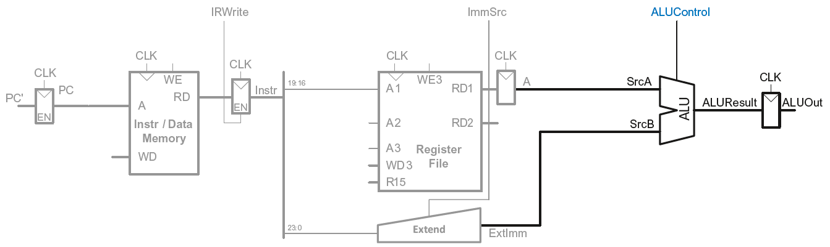
Multicycle Datapath: LDR Address
STEP 3: Compute the memory address
LDR Rd, [Rn, imm12]

Slide 85
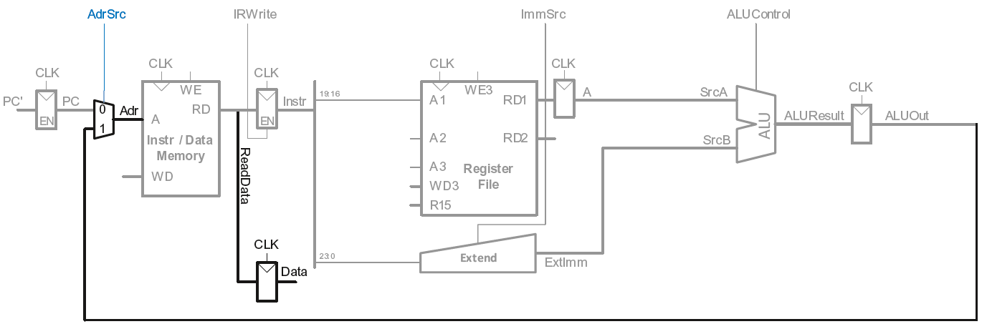
Multicycle Datapath: LDR Memory Read
STEP 4: Read data from memory
LDR Rd, [Rn, imm12]

Slide 86
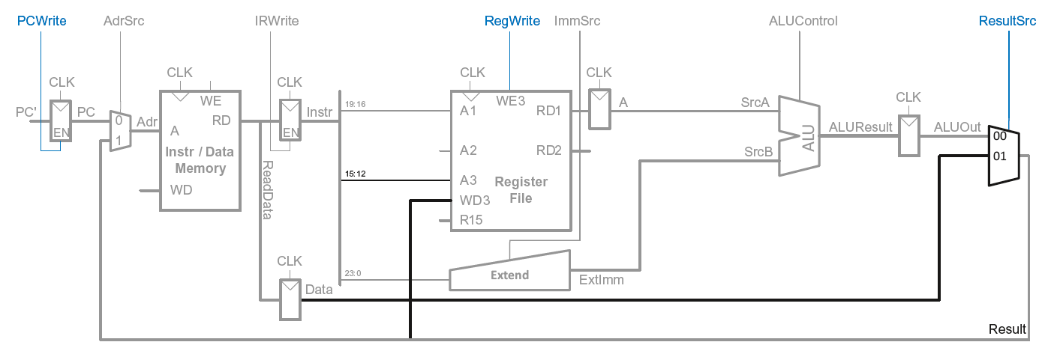
Multicycle Datapath: LDR Write Register
STEP 5: Write data back to register file
LDR Rd, [Rn, imm12]

Slide 87
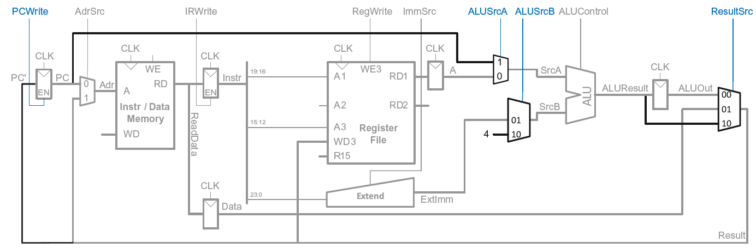
Multicycle Datapath: Increment PC
STEP 6: Increment PC

Slide 88
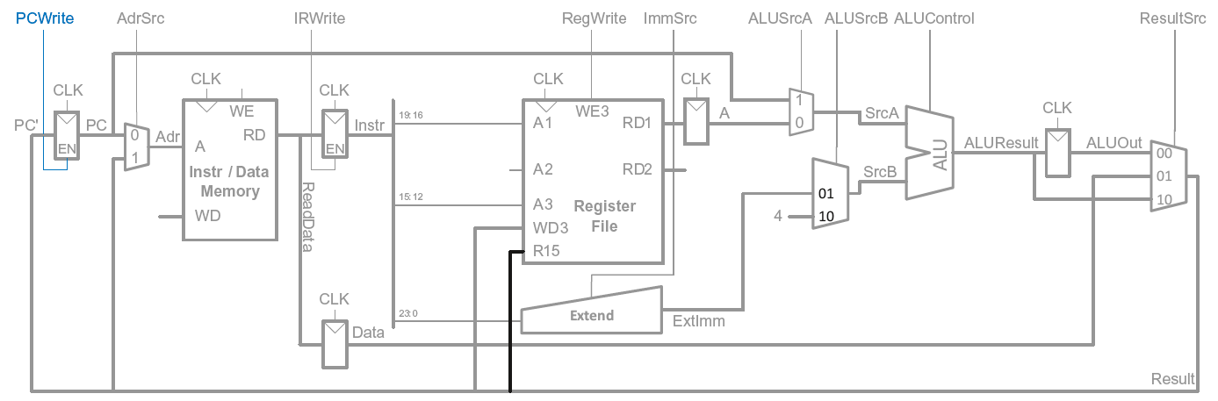
Multicycle Datapath: Access to PC
PC can be read/written by instruction

Slide 89
Multicycle Datapath: Access to PC
PC can be read/written by instruction
Read: R15 (PC+8) available in Register File

Slide 90
Multicycle Datapath: Read to PC (R15)
Example: ADD R1, R15, R2

Slide 91
Multicycle Datapath: Read to PC (R15)
Example: ADD R1, R15, R2
R15 needs to be read as PC+8 from Register File (RF) in 2nd step
So (also in 2nd step) PC + 8 is produced by ALU and routed to R15 input of RF

Slide 92
Multicycle Datapath: Read to PC (R15)
Example: ADD R1, R15, R2
R15 needs to be read as PC+8 from Register File (RF) in 2nd step
So (also in 2nd step) PC + 8 is produced by ALU and routed to R15 input of RF
SrcA = PC (which was already updated in step 1 to PC+4)
SrcB = 4
ALUResult = PC + 8
ALUResult is fed to R15 input port of RF in 2nd step (which is then routed to RD1 output of RF)

Slide 93
Multicycle Datapath: Read to PC (R15)
Example: ADD R1, R15, R2
R15 needs to be read as PC+8 from Register File (RF) in 2nd step
So (also in 2nd step) PC + 8 is produced by ALU and routed to R15 input of RF

Slide 94
Multicycle Datapath: Access to PC
PC can be read/written by instruction
Read: R15 (PC+8) available in Register File
Write: Be able to write result of instruction to PC

Slide 95
Multicycle Datapath: Write to PC (R15)
Example: SUB R15, R8, R3

Slide 96
Multicycle Datapath: Write to PC (R15)
Example: SUB R15, R8, R3
Result of instruction needs to be written to the PC register
ALUResult already routed to the PC register, just assert PCWrite

Slide 97
Multicycle Datapath: Write to PC (R15)
Example: SUB R15, R8, R3
Result of instruction needs to be written to the PC register
ALUResult already routed to the PC register, just assert PCWrite

Slide 98
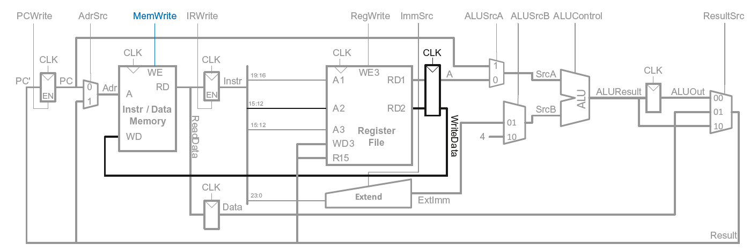
Multicycle Datapath: STR
Write data in Rn to memory

Slide 99
Multicycle Datapath: Data-processing
With immediate addressing (i.e., an immediate Src2), no additional changes needed for datapath

Slide 100
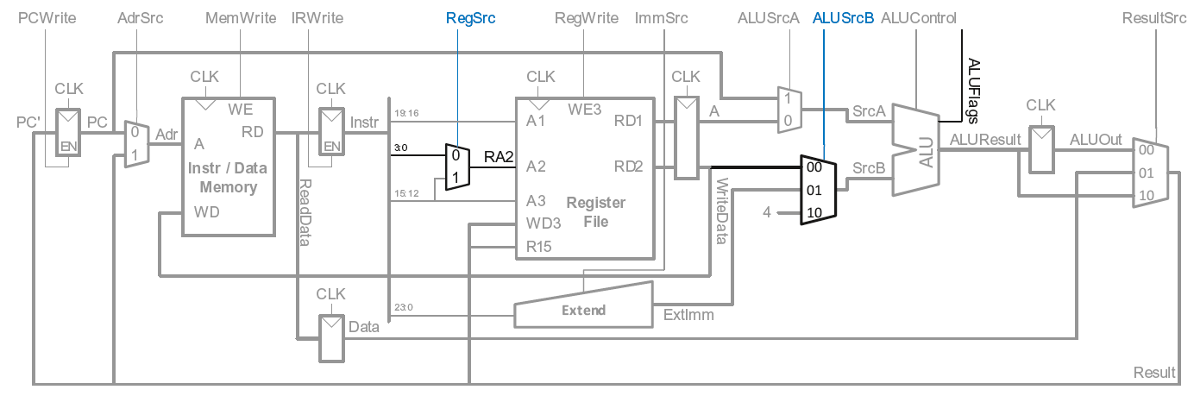
Multicycle Datapath: Data-processing
With register addressing (register Src2):
Read from Rn and Rm

Slide 101
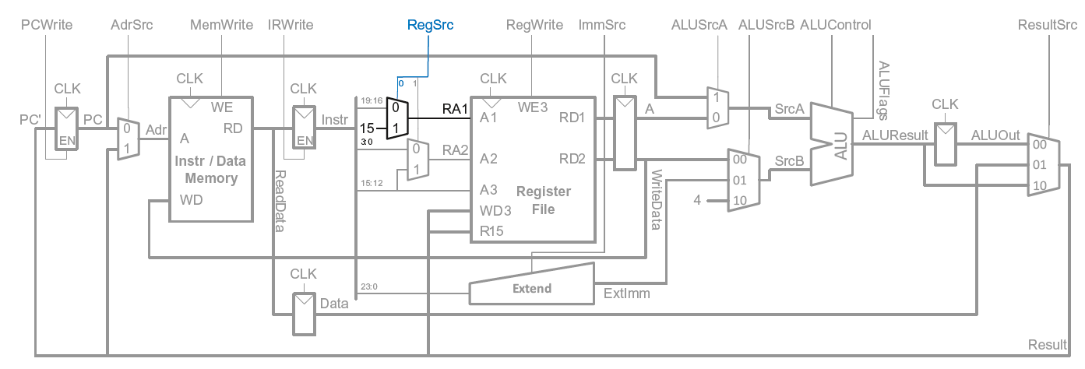
Multicycle Datapath: B
Calculate branch target address:
BTA = (ExtImm) + (PC+8)
ExtImm = Imm24 << 2 and sign-extended

Slide 102
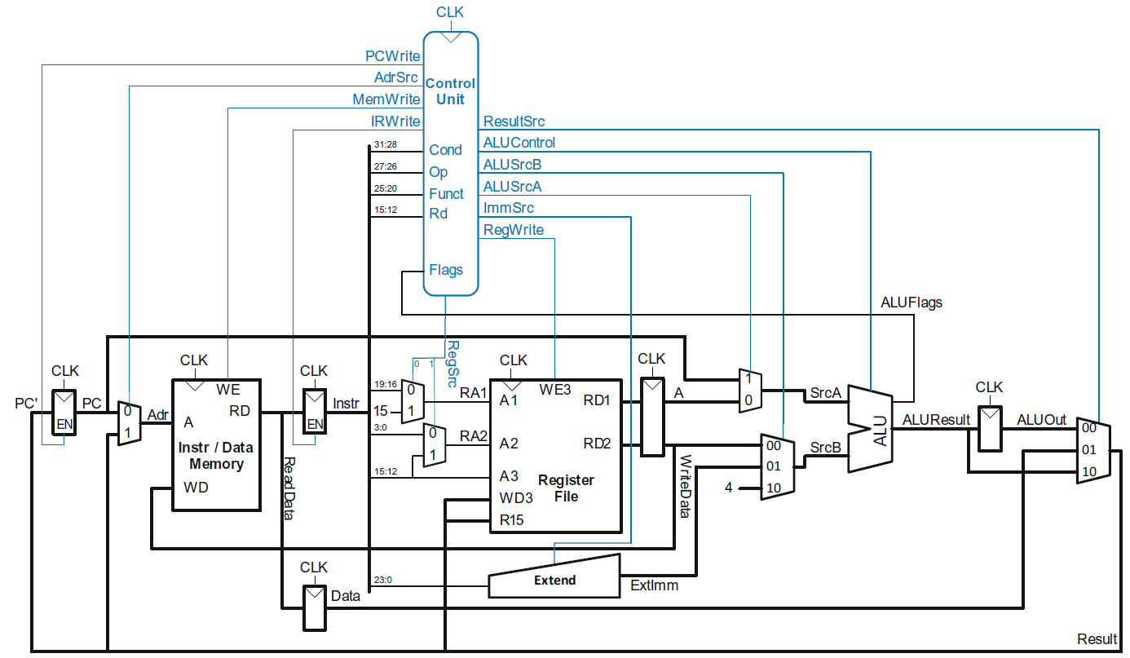
Multicycle ARM Processor

Slide 103
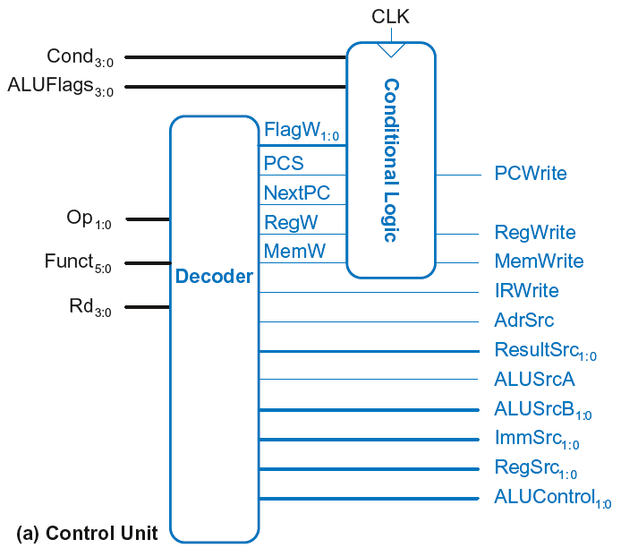
Multicycle Control
First, discuss Decoder
Then, Conditional Logic

Slide 104
Multicycle Control: Decoder

Slide 105
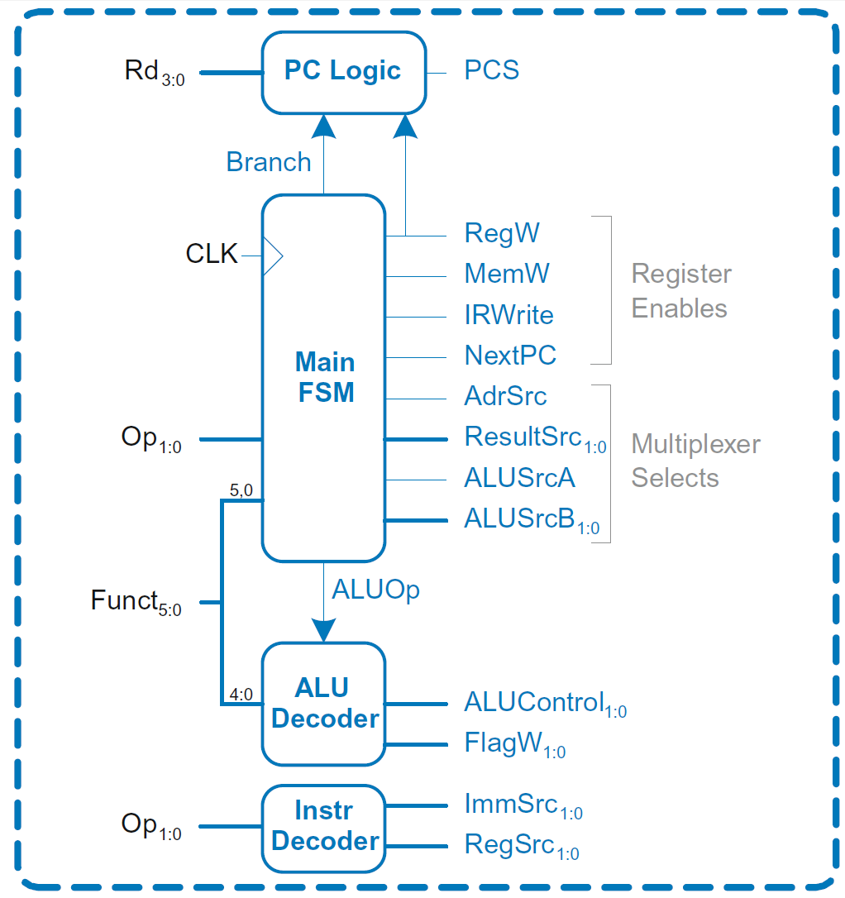
Multicycle Control: Decoder
Decoder

Slide 106
Multicycle Control: Decoder
ALU Decoder and PC Logic same as single-cycle

Slide 107
Multicycle Control: Instr Decoder
RegSrc₀ = (Op == 10₂)
RegSrc₁ = (Op == 01₂)
ImmSrc_{1:0} = Op
Instruction | Op | Funct₅ | Funct₀ | RegSrc₀ | RegSrc₁ | ImmSrc_{1:0}
LDR | 01 | X | 1 | 0 | X | 01
STR | 01 | X | 0 | 0 | 1 | 01
DP immediate | 00 | 1 | X | 0 | X | 00
DP register | 00 | 0 | X | 0 | 0 | 00
B | 10 | X | X | 1 | X | 10

Slide 108
Multicycle ARM Processor

Slide 109
Multicycle Control: Main FSM
Decoder

Slide 110
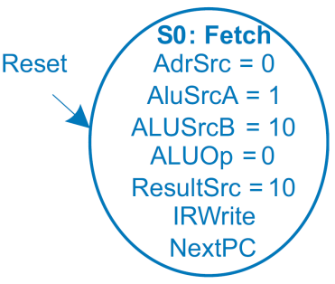

Main Controller FSM: Fetch

Slide 111
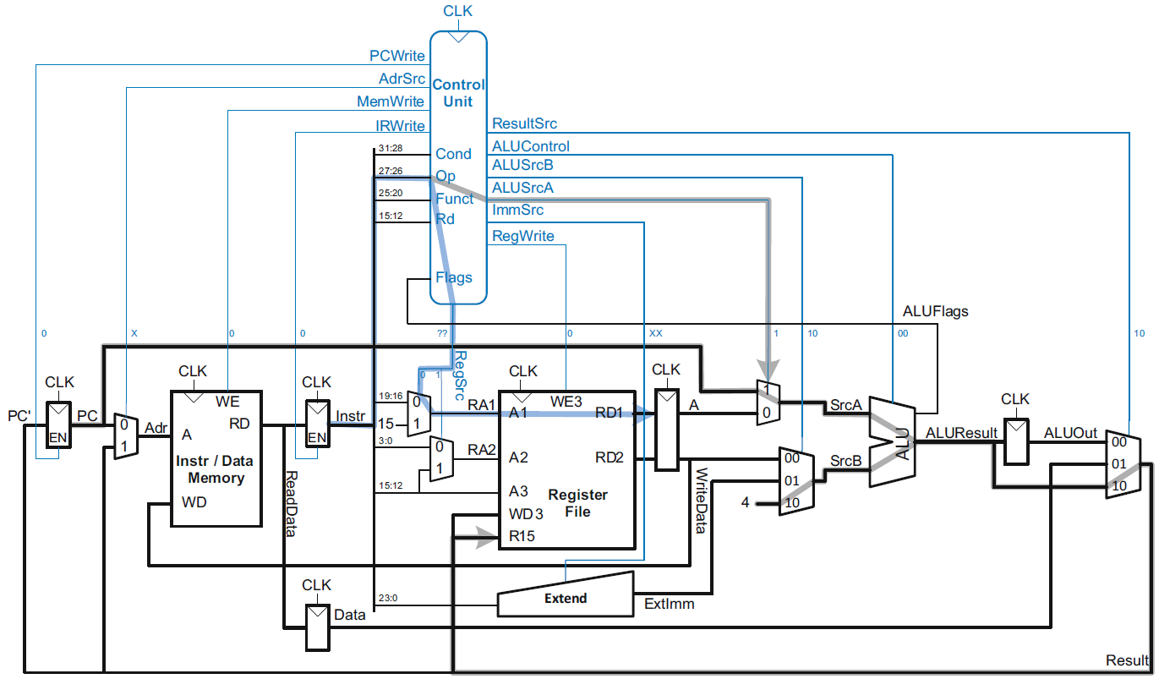
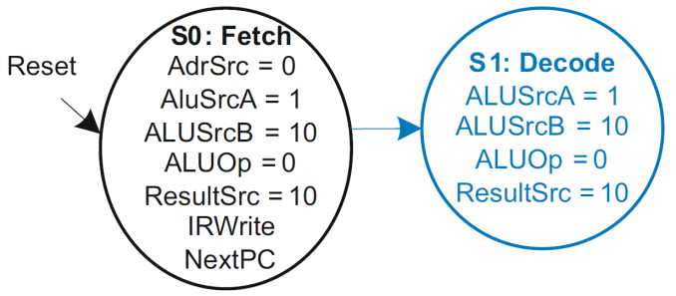
Main Controller FSM: Decode

Slide 112
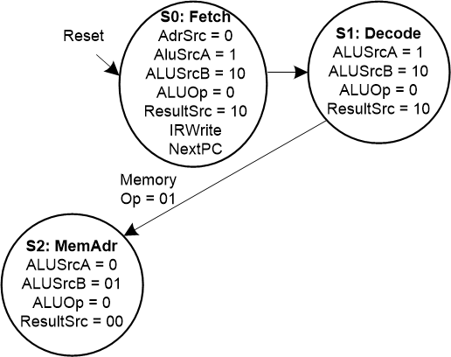
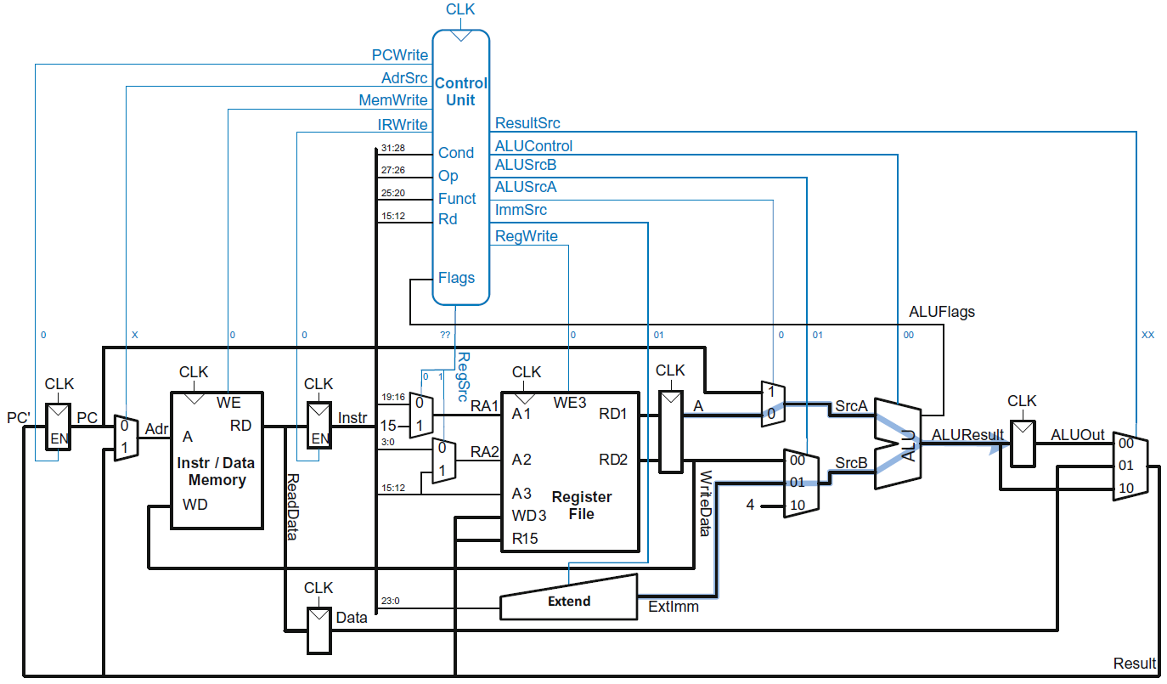
Main Controller FSM: Address

Slide 113
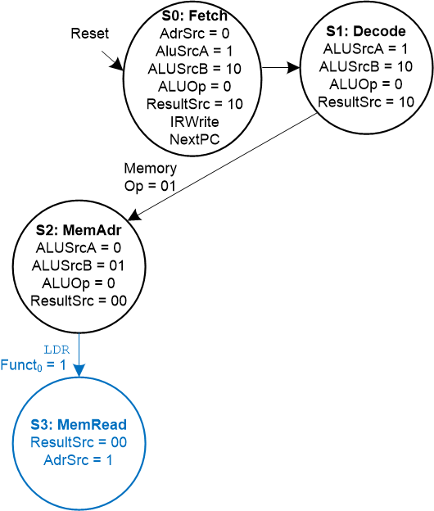
Main Controller FSM: Read Memory

Slide 114
Multicycle ARM Processor

Slide 115
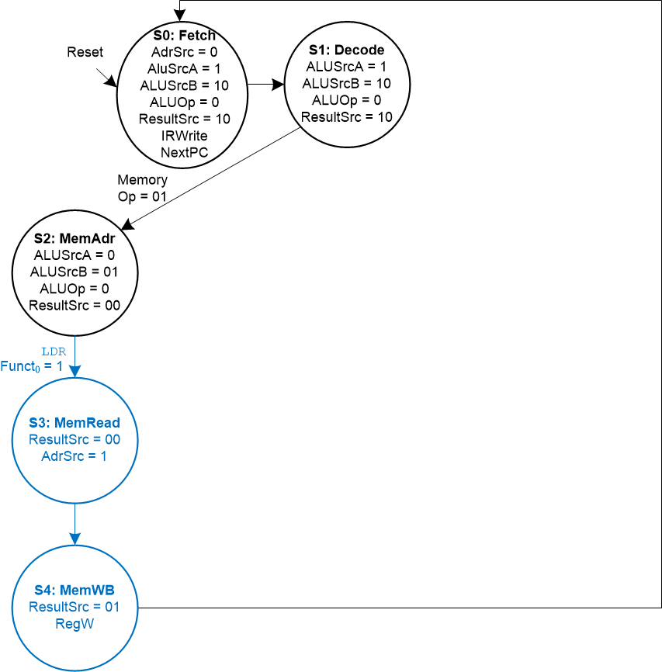
Main Controller FSM: LDR

Slide 116
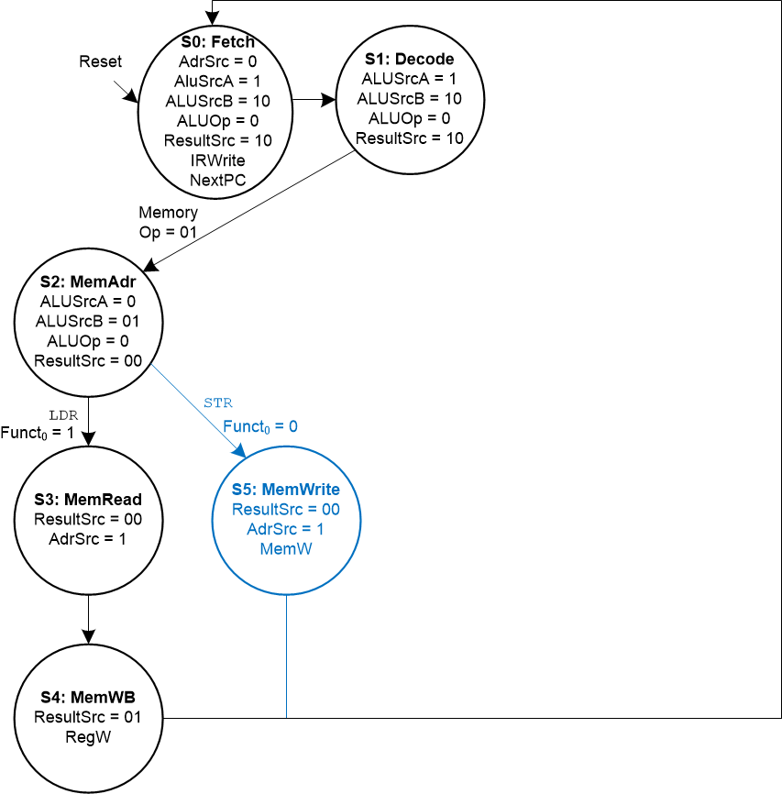
Main Controller FSM: STR

Slide 117
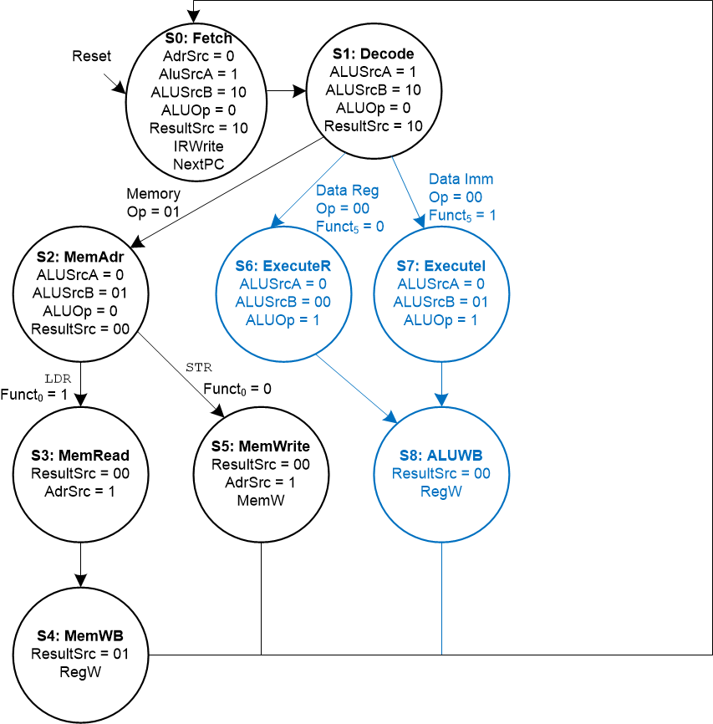
Main Controller FSM: Data-processing

Slide 118
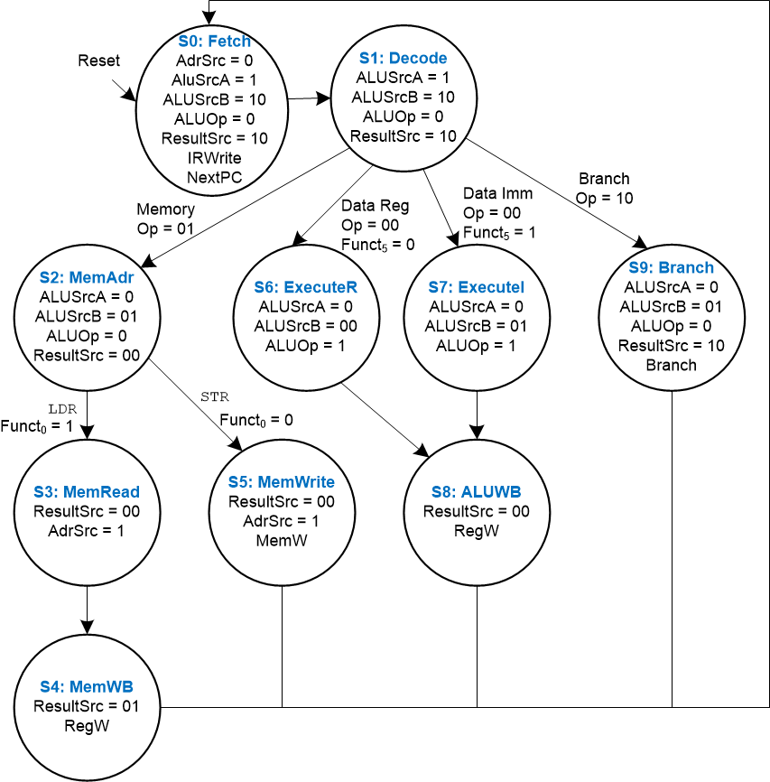
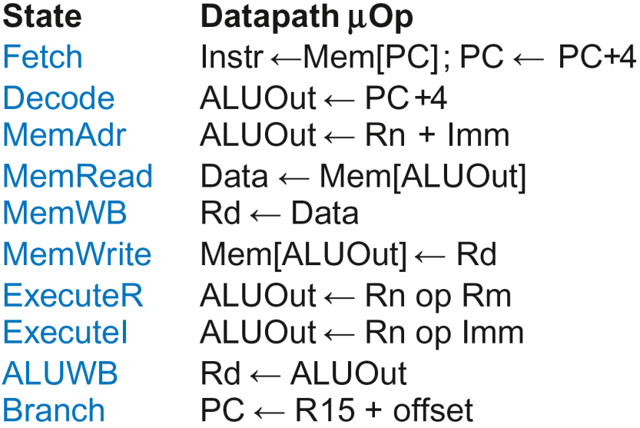
Multicycle Controller FSM

Slide 119
Multicycle Control
First, discuss Decoder
Then, Conditional Logic

Slide 120
Multicycle Control: Cond. Logic

Slide 121
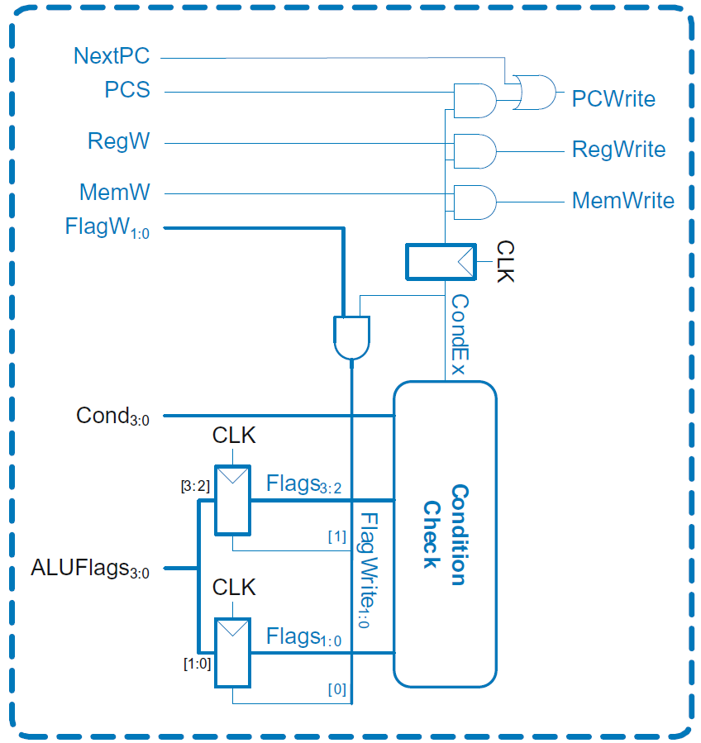
Single-Cycle Conditional Logic

Slide 122
Multicycle Conditional Logic
PCWrite asserted in Fetch state
ExecuteI/ExecuteR state:
CondEx asserts
ALUFlags generated
ALUWB state:
Flags updated
CondEx changes
PCWrite, RegWrite, and
MemWrite don’t see
change till new
instruction (Fetch state)

Slide 123
Multicycle Processor Performance
Instructions take different number of cycles.

Slide 124
Multicycle Controller FSM

Slide 125
Multicycle Processor Performance
Instructions take different number of cycles:
3 cycles:
4 cycles:
5 cycles:

Slide 126
Multicycle Processor Performance
Instructions take different number of cycles:
3 cycles: B
4 cycles: DP, STR
5 cycles: LDR

Slide 127
Multicycle Processor Performance
Instructions take different number of cycles:
3 cycles: B
4 cycles: DP, STR
5 cycles: LDR
CPI is weighted average
SPECINT2000 benchmark:
25% loads
10% stores
13% branches
52% R-type

Slide 128
Multicycle Processor Performance
Instructions take different number of cycles:
3 cycles: B
4 cycles: DP, STR
5 cycles: LDR
CPI is weighted average
SPECINT2000 benchmark:
25% loads
10% stores
13% branches
52% R-type
Average CPI = (0.13)(3) + (0.52 + 0.10)(4) + (0.25)(5) = 4.12

Slide 129
Multicycle Processor Performance
Multicycle critical path:
Assumptions:
RF is faster than memory
writing memory is faster than reading memory
T_{c2} = t_{pcq} + 2t_{mux} + max(t_{ALU} + t_{mux}, t_{mem}) + t_{setup}

Slide 130
Multicycle Performance Example
Element | Parameter | Delay (ps)
Register clock-to-Q | t_{pcq_PC} | 40
Register setup | t_{setup} | 50
Multiplexer | t_{mux} | 25
ALU | t_{ALU} | 120
Decoder | t_{dec} | 70
Memory read | t_{mem} | 200
Register file read | t_{RFread} | 100
Register file setup | t_{RFsetup} | 60
T_{c2} = ?

Slide 131
Multicycle Performance Example
Element | Parameter | Delay (ps)
Register clock-to-Q | t_{pcq_PC} | 40
Register setup | t_{setup} | 50
Multiplexer | t_{mux} | 25
ALU | t_{ALU} | 120
Decoder | t_{dec} | 70
Memory read | t_{mem} | 200
Register file read | t_{RFread} | 100
Register file setup | t_{RFsetup} | 60
T_{c2} = t_{pcq} + 2t_{mux} + max[t_{ALU} + t_{mux}, t_{mem}] + t_{setup}
= [40 + 2(25) + 200 + 50] ps = 340 ps

Slide 132
Multicycle Performance Example
For a program with 100 billion instructions executing on a multicycle ARM processor
CPI = 4.12 cycles/instruction
Clock cycle time: T_{c2} = 340 ps
Execution Time = ?

Slide 133
Multicycle Performance Example
For a program with 100 billion instructions executing on a multicycle ARM processor
CPI = 4.12 cycles/instruction
Clock cycle time: T_{c2} = 340 ps
Execution Time = (# instructions) × CPI × T_{c}
= (100 × 10⁹)(4.12)(340 × 10⁻¹²)
= 140 seconds

Slide 134
Multicycle Performance Example
For a program with 100 billion instructions executing on a multicycle ARM processor
CPI = 4.12 cycles/instruction
Clock cycle time: T_{c2} = 340 ps
Execution Time = (# instructions) × CPI × T_{c}
= (100 × 10⁹)(4.12)(340 × 10⁻¹²)
= 140 seconds
This is slower than the single-cycle processor (84 sec.)

Slide 135
Review: Single-Cycle ARM Processor

Slide 136
Review: Multicycle ARM Processor

Slide 137
Pipelined ARM Processor
Temporal parallelism
Divide single-cycle processor into 5 stages:
Fetch
Decode
Execute
Memory
Writeback
Add pipeline registers between stages

Slide 138
Single-Cycle vs. Pipelined

Slide 139
Pipelined Processor Abstraction

Slide 140
Single-Cycle & Pipelined Datapath

Slide 141
Corrected Pipelined Datapath
WA3 must arrive at same time as Result
Register file written on falling edge of CLK

Slide 142
Optimized Pipelined Datapath
Remove adder by using PCPlus4F after PC has been updated to PC+4

Slide 143
Pipelined Processor Control
Same control unit as single-cycle processor
Control delayed to proper pipeline stage

Slide 144
Pipeline Hazards
When an instruction depends on result from instruction that hasn’t completed
Types:
Data hazard: register value not yet written back to register file
Control hazard: next instruction not decided yet (caused by branch)

Slide 145
Data Hazard

Slide 146
Handling Data Hazards
Insert NOPs in code at compile time
Rearrange code at compile time
Forward data at run time
Stall the processor at run time

Slide 147
Compile-Time Hazard Elimination
Insert enough NOPs for result to be ready
Or move independent useful instructions forward

Slide 148
Data Forwarding

Slide 149
Data Forwarding
Check if register read in Execute stage matches register written in Memory or Writeback stage
If so, forward result

Slide 150
Data Forwarding

Slide 151
Data Forwarding
Execute stage register matches Memory stage register?
Match_1E_M = (RA1E == WA3M)
Match_2E_M = (RA2E == WA3M)
Execute stage register matches Writeback stage register?
Match_1E_W = (RA1E == WA3W)
Match_2E_W = (RA2E == WA3W)
If it matches, forward result:
if (Match_1E_M • RegWriteM) ForwardAE = 10;
else if (Match_1E_W • RegWriteW) ForwardAE = 01;
else ForwardAE = 00;

Slide 152
Data Forwarding
Execute stage register matches Memory stage register?
Match_1E_M = (RA1E == WA3M)
Match_2E_M = (RA2E == WA3M)
Execute stage register matches Writeback stage register?
Match_1E_W = (RA1E == WA3W)
Match_2E_W = (RA2E == WA3W)
If it matches, forward result:
if (Match_1E_M • RegWriteM) ForwardAE = 10;
else if (Match_1E_W • RegWriteW) ForwardAE = 01;
else ForwardAE = 00;
ForwardBE same but with Match2E

Slide 153
Stalling

Slide 154
Stalling

Slide 155
Stalling Hardware

Slide 156
Stalling Logic
Is either source register in the Decode stage the same as the one being written in the Execute stage?
Match_12D_E = (RA1D == WA3E) + (RA2D == WA3E)
Is a LDR in the Execute stage AND Match_12D_E?
ldrstall = Match_12D_E • MemtoRegE
StallF = StallD = FlushE = ldrstall

Slide 157
Control Hazards
B:
branch not determined until the Writeback stage of pipeline
Instructions after branch fetched before branch occurs
These 4 instructions must be flushed if branch happens
Writes to PC (R15) similar

Slide 158
Control Hazards
Branch misprediction penalty
number of instruction flushed when branch is taken (4)
May be reduced by determining BTA earlier

Slide 159
Early Branch Resolution
Determine BTA in Execute stage
Branch misprediction penalty = 2 cycles
Hardware changes
Add a branch multiplexer before PC register to select BTA from ALUResultE
Add BranchTakenE select signal for this multiplexer (only asserted if branch condition satisfied)
PCSrcW now only asserted for writes to PC

Slide 160
Pipelined processor with Early BTA

Slide 161
Control Hazards with Early BTA

Slide 162
Control Stalling Logic
PCWrPendingF = 1 if write to PC in Decode, Execute or Memory
PCWrPendingF = PCSrcD + PCSrcE + PCSrcM
Stall Fetch if PCWrPendingF
StallF = ldrStallD + PCWrPendingF
Flush Decode if PCWrPendingF OR PC is written in Writeback OR branch is taken
FlushD = PCWrPendingF + PCSrcW + BranchTakenE
Flush Execute if branch is taken
FlushE = ldrStallD + BranchTakenE
Stall Decode if ldrStallD (as before)
StallD = ldrStallD

Slide 163
ARM Pipelined Processor with Hazard Unit

Slide 164
Pipelined Performance Example
SPECINT2000 benchmark:
25% loads
10% stores
13% branches
52% R-type
Suppose:
40% of loads used by next instruction
50% of branches mispredicted
What is the average CPI?

Slide 165
Pipelined Performance Example
SPECINT2000 benchmark:
25% loads
10% stores
13% branches
52% R-type
Suppose:
40% of loads used by next instruction
50% of branches mispredicted
What is the average CPI?
Load CPI = 1 when not stalling, 2 when stalling
So, CPI_{lw} = 1(0.6) + 2(0.4) = 1.4
Branch CPI = 1 when not stalling, 3 when stalling
So, CPI_{beq} = 1(0.5) + 3(0.5) = 2
Average CPI = (0.25)(1.4) + (0.1)(1) + (0.13)(2) + (0.52)(1) = 1.23

Slide 166
Pipelined Performance
Pipelined processor critical path:
T_{c3} = max [
t_{pcq} + t_{mem} + t_{setup} Fetch
2(t_{RFread} + t_{setup} ) Decode
t_{pcq} + 2t_{mux} + t_{ALU} + t_{setup} Execute
t_{pcq} + t_{mem} + t_{setup} Memory
2(t_{pcq} + t_{mux} + t_{RFwrite}) ] Writeback

Slide 167
Pipelined Performance Example
Element | Parameter | Delay (ps)
Register clock-to-Q | t_{pcq_PC} | 40
Register setup | t_{setup} | 50
Multiplexer | t_{mux} | 25
ALU | t_{ALU} | 120
Memory read | t_{mem} | 200
Register file read | t_{RFread} | 100
Register file setup | t_{RFsetup} | 60
Register file write | t_{RFwrite} | 70
Cycle time: T_{c3} = ?

Slide 168
Pipelined Performance Example
Element | Parameter | Delay (ps)
Register clock-to-Q | t_{pcq_PC} | 40
Register setup | t_{setup} | 50
Multiplexer | t_{mux} | 25
ALU | t_{ALU} | 120
Memory read | t_{mem} | 200
Register file read | t_{RFread} | 100
Register file setup | t_{RFsetup} | 60
Register file write | t_{RFwrite} | 70
Cycle time: T_{c3} = 2(t_{RFread} + t_{setup} )
= 2[100 + 50] ps = 300 ps

Slide 169
Pipelined Performance Example
Program with 100 billion instructions
Execution Time = (# instructions) × CPI × T_{c}
= (100 × 10⁹)(1.23)(300 × 10⁻¹²)
= 36.9 seconds

Slide 170
Processor Performance Comparison
Processor | Execution Time (seconds) | Speedup (single-cycle as baseline)
Single-cycle | 84 | 1
Multicycle | 140 | 0.6
Pipelined | 36.9 | 2.28

Slide 171
Advanced Microarchitecture
Deep Pipelining
Micro-operations
Branch Prediction
Superscalar Processors
Out of Order Processors
Register Renaming
SIMD
Multithreading
Multiprocessors

Slide 172
Deep Pipelining
10-20 stages typical
Number of stages limited by:
Pipeline hazards
Sequencing overhead
Power
Cost

Slide 173
Micro-operations
Decompose more complex instructions into a series of simple instructions called micro-operations (micro-ops or µ-ops)
At run-time, complex instructions are decoded into one or more micro-ops
Used heavily in CISC (complex instruction set computer) architectures (e.g., x86)
Used for some ARM instructions, for example:
Complex Op Micro-op Sequence
LDR R1, [R2], #4 LDR R1, [R2]
ADD R2, R2, #4
Without u-ops, would need 2nd write port on the register file

Slide 174
Micro-operations
Allow for dense code (fewer memory accesses)
Yet preserve simplicity of RISC hardware
ARM strikes balance by choosing instructions that:
Give better code density than pure RISC instruction sets (such as MIPS)
Enable more efficient decoding than CISC instruction sets (such as x86)

Slide 175
Branch Prediction
Guess whether branch will be taken
Backward branches are usually taken (loops)
Consider history to improve guess
Good prediction reduces fraction of branches requiring a flush

Slide 176
Branch Prediction
Ideal pipelined processor: CPI = 1
Branch misprediction increases CPI
Static branch prediction:
Check direction of branch (forward or backward)
If backward, predict taken
Else, predict not taken
Dynamic branch prediction:
Keep history of last several hundred (or thousand) branches in branch target buffer, record:
Branch destination
Whether branch was taken

Slide 177
Branch Prediction Example
MOV R1, #0 ; R1 = sum
MOV R0, #0 ; R0 = i
FOR ; for (i=0; i<10; i=i+1)
CMP R0, #10
BGE DONE
ADD R1, R1, R0 ; sum = sum + i
ADD R0, R0, #1
B FOR
DONE

Slide 178
1-Bit Branch Predictor
Remembers whether branch was taken the last time and does the same thing
Mispredicts first and last branch of loop

Slide 179
2-Bit Branch Predictor
Only mispredicts last branch of loop

Slide 180
Superscalar
Multiple copies of datapath execute multiple instructions at once
Dependencies make it tricky to issue multiple instructions at once

Slide 181
Superscalar Example
Ideal IPC: 2
Actual IPC: 2

Slide 182
Superscalar with Dependencies
Ideal IPC: 2
Actual IPC: 6/5 = 1.2

Slide 183
Out of Order Processor
Looks ahead across multiple instructions
Issues as many instructions as possible at once
Issues instructions out of order (as long as no dependencies)
Dependencies:
RAW (read after write): one instruction writes, later instruction reads a register
WAR (write after read): one instruction reads, later instruction writes a register
WAW (write after write): one instruction writes, later instruction writes a register

Slide 184
Out of Order Processor
Instruction level parallelism (ILP): number of instruction that can be issued simultaneously (average < 3)
Scoreboard: table that keeps track of:
Instructions waiting to issue
Available functional units
Dependencies

Slide 185
Out of Order Processor Example
LDR R8, [R0, #40]
ADD R9, R8, R1
SUB R8, R2, R3 Ideal IPC: 2
AND R10, R4, R8 Actual IPC: 6/4 = 1.5
ORR R11, R5, R6
STR R7, [R11, #80]

Slide 186
Register Renaming
LDR R8, [R0, #40]
ADD R9, R8, R1
SUB R8, R2, R3 Ideal IPC: 2
AND R10, R4, R8 Actual IPC: 6/3 = 2
ORR R11, R5, R6
STR R7, [R11, #80]

Slide 187
SIMD
Single Instruction Multiple Data (SIMD)
Single instruction acts on multiple pieces of data at once
Common application: graphics
Perform short arithmetic operations (also called packed arithmetic)
For example, add eight 8-bit elements

Slide 188
Advanced Architecture Techniques
Multithreading
Wordprocessor: thread for typing, spell checking, printing
Multiprocessors
Multiple processors (cores) on a single chip

Slide 189
Threading: Definitions
Process: program running on a computer
Multiple processes can run at once: e.g., surfing Web, playing music, writing a paper
Thread: part of a program
Each process has multiple threads: e.g., a word processor may have threads for typing, spell checking, printing

Slide 190
Threads in Conventional Processor
One thread runs at once
When one thread stalls (for example, waiting for memory):
Architectural state of that thread stored
Architectural state of waiting thread loaded into processor and it runs
Called context switching
Appears to user like all threads running simultaneously

Slide 191
Multithreading
Multiple copies of architectural state
Multiple threads active at once:
When one thread stalls, another runs immediately
If one thread can’t keep all execution units busy, another thread can use them
Does not increase instruction-level parallelism (ILP) of single thread, but increases throughput
Intel calls this “hyperthreading”

Slide 192
Multiprocessors
Multiple processors (cores) with a method of communication between them
Types:
Homogeneous: multiple cores with shared main memory
Heterogeneous: separate cores for different tasks (for example, DSP and CPU in cell phone)
Clusters: each core has own memory system

Slide 193
Other Resources
Patterson & Hennessy’s: Computer Architecture: A Quantitative Approach
Conferences:
www.cs.wisc.edu/~arch/www/
ISCA (International Symposium on Computer Architecture)
HPCA (International Symposium on High Performance Computer Architecture)

